Slide 1
US Army Corps of Engineers
New England District
SAME Forum – 19 Apr 16
COL Chris Barron

Slide 2
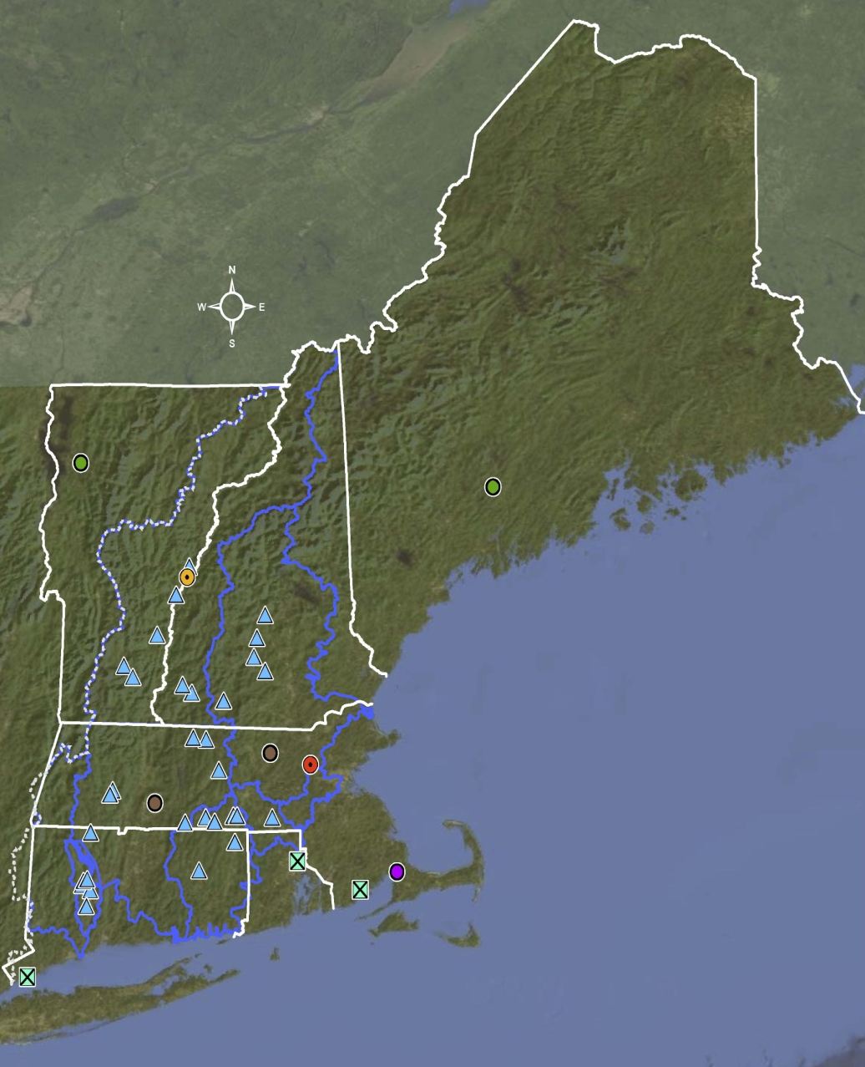
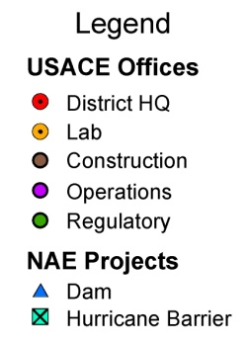
The Tale of the Tape
6 Governors
12 Senators
21 Congressional Districts
13 million people
66,000 square miles
6,100 miles of coastline
11 deep draft commercial waterways
13 major river basins
168 Federal harbors
5 Military Bases
470 Employees
31 Dams; 5 Basin Offices
4 Resident Engr, 2 Regulatory Offices
3 Hurricane Barriers
Cape Cod Canal
~ 2500 Permits issued annually
$64M military program
$131M CW program
$53M IIES program
One of six districts in the North Atlantic Division that deliver a broad spectrum of programs/ projects to New England and the Nation
St. John River
Watershed
St. Croix River
Watershed – IJC
Upper
Connecticut
Merrimack
Lower
Connecticut
Thames
Fox
Point
Cape Cod Canal
Naugatuck
New
Bedford
Stamford
NAE = EPA = FEMA boundaries

Slide 3
Work We Need
Major vertical construction – schools, military barracks, offices, medical clinics, laboratories
Bridge renovations & repairs
Dredging – mechanical and hydraulic; harbors large and small
Building roof repair, façade repair, HVAC upgrades and interior renovations
Jetty and breakwater rebuild and repair
Environmental remediation / HTRW support
A/E Design
Dam and gate repair and renovations
Professional services and supplies
Security upgrades to existing structures – fences, cameras, etc
Road repair and drainage
Sustainable or renewable energy supplies

Slide 4
Work We Need
Navigation Maintenance
Boston Inner Harbor (Boston, MA) $15-20 M
Sagamore Creek (Portsmouth, NH) $100-500 K
Housatonic River (Stratford, CT) $5-10 M
Mianus River (Greenwich, CT) $1-5 M
Navigation Improvement
Boston Harbor (Boston, MA) $250 M
Portsmouth Harbor (Portsmouth, NH) $20 M

Slide 5
Work We Need
Jetty Repair
Green Harbor Jetty (Marshfield, MA) $1-5 M
Scituate Harbor Jetty (Greenwich, CT) $1-5 M
Plymouth Long Beach (Plymouth, MA) $1 M
Construction
FDA Lab (Winchester, MA) $40 M
IDIQ
Construction MATOC (various NE) $35 M
Environmental Services (various NE) $5 M
Environmental Services (various NE) $25 M

Slide 6
Work We Need
MILCON
Sys Mgt Facility (Hanscom AFB, MA) $15-25 M
MIT / Lincoln Labs (HAFB) $15-25 M
MIT / Lincoln Labs (HAFB) $150-250 M
Vandenburg Gate (HAFB) $15-25 M
Army Family Housing (Natick, MA) $10-15 M

Slide 7
Work We Need
MILITARY O&M / SRM
Building Modern. (Ft Devens, MA) $5-10 M
Roof Repair (FDMA) $1-5 M
Building Reno (Natick, MA) $3-5 M
FUDS BD/DR (NY / NJ sites) $1-5 M
FUDS Soil (Bayside, NY) $100-500 K
FUDS Soil (St Albans, VT) $100-500 K

Slide 8
Work We Need
EPA Superfund
Elizabeth Mines (Straftord, VT) $25 M
Callahan Mine (Brooksville, ME) $40 M
Dredging (New Bedford, MA) $20-25M
Water Distribution System
(Durham Meadows, CT) $15-20 M
Raymark OU#6 (Stratford, CT) $1-5 M

Slide 9
Contact
All Corps Business Opportunities are posted on:
www.fbo.gov
Further information available from:
New England District Small Business Office
Eva Marie D’Antuono
978-318-8427
Evamarie.dantuono@usace.army.mil

Slide 10
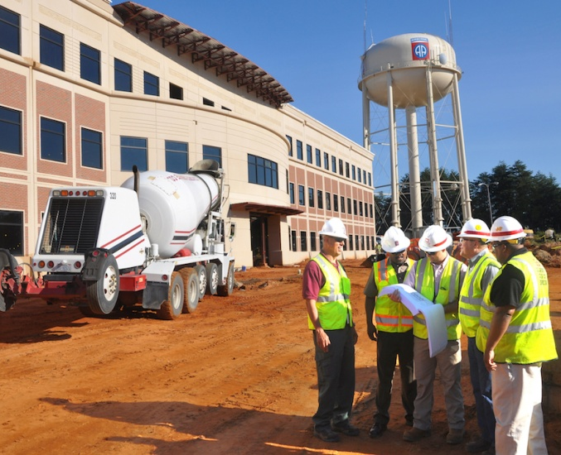
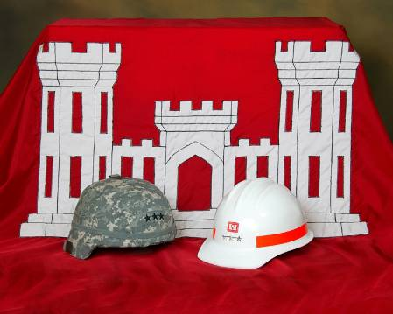
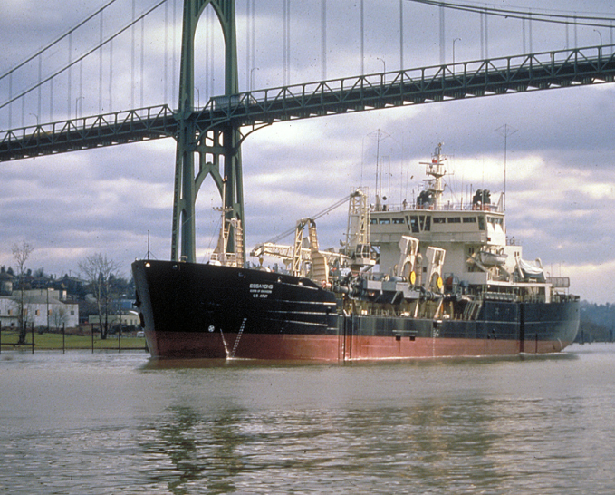
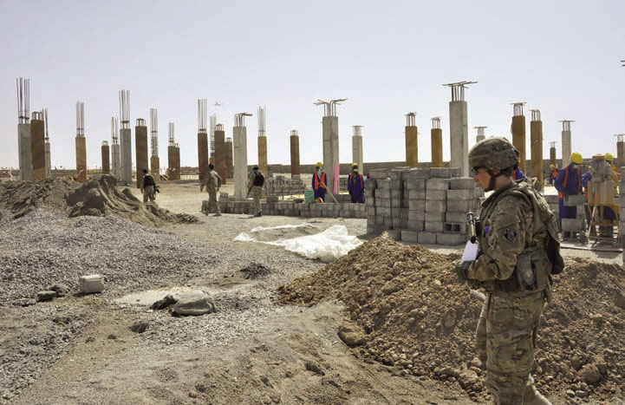
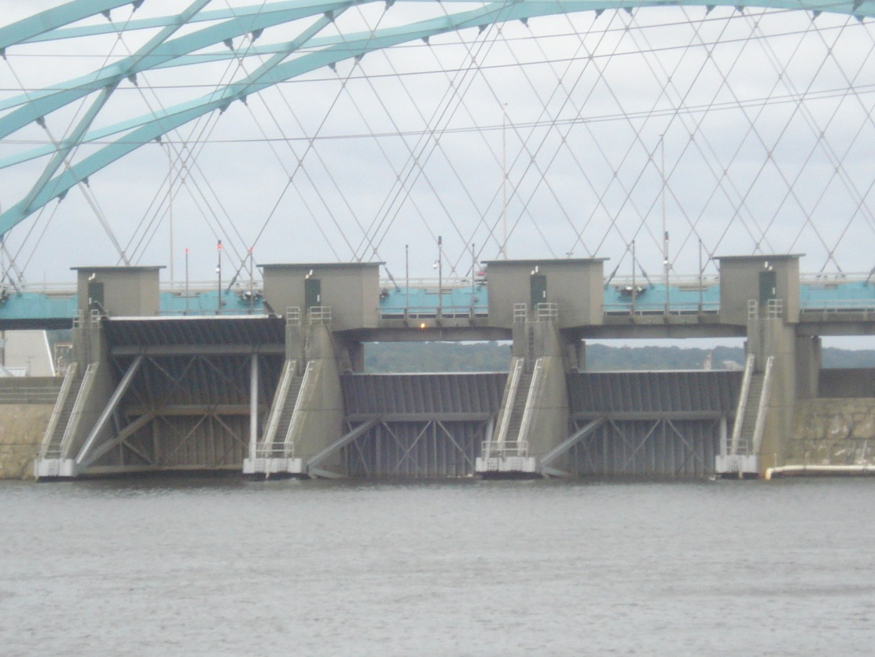
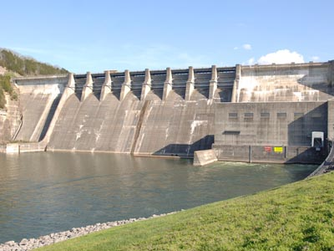
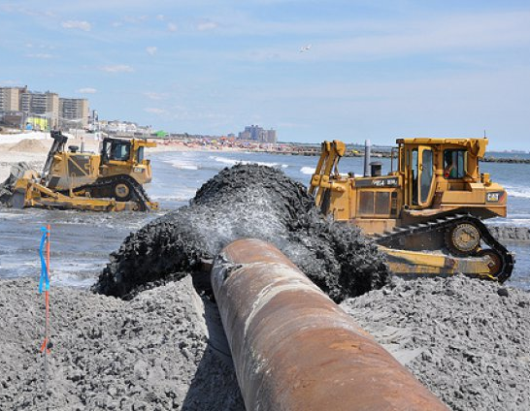
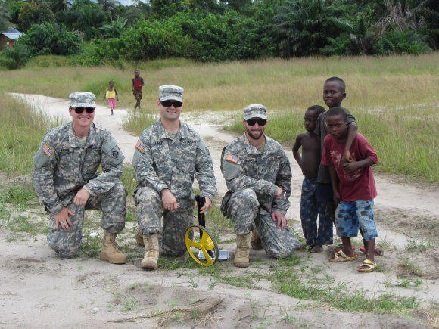
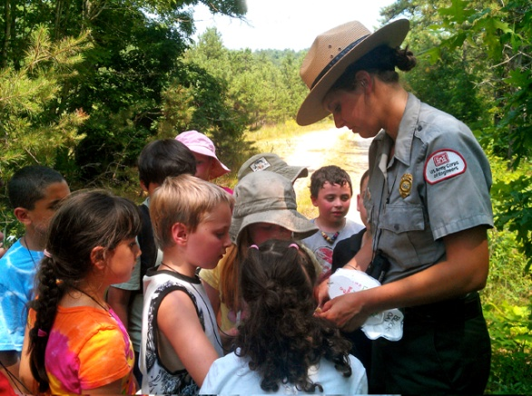
Questions?

